Slide 1
Come in Quietly
Take out your chromebook but keep it closed.

Slide 2
Objective: Identify and describe the Principles of the Constitution
Objective
Standard 8.2.7: Describe the principles of federalism, dual sovereignty, separation of powers, checks and balances, the nature and purpose of majority rule, and the ways in which the American idea of constitutionalism preserves individual rights.
8.RH.7: Integrate visual information (e.g., in charts, graphs, photos, videos, or maps) with other information in print and digital texts.

Slide 3
The Principles of the Constitution
Concept

Slide 4
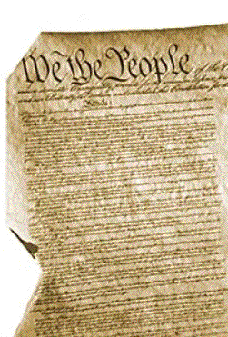
The Constitution
Concept
The Constitution is the rules for running our government.
The Constitution is the supreme law of the land.

Slide 5
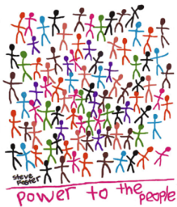
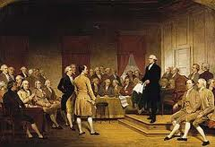
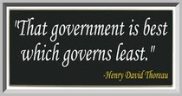
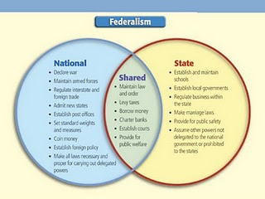
Concept
The Principles of the Constitution
Principles are the beliefs about the purpose and running of a government.
1. Popular Sovereignty – (people power) the government derives its power from the people.
2. Republicanism - (I vote for you) the
people choose their government leaders.
3. Limited Government – (only what I let you)
government only has the
powers the people give it.
4. Federalism – (share the power) the power to govern is shared between the national government and the states.
3 types of government powers.
Enumerated – Belong only to the Federal Government
Reserved – powers retained by the states
Concurrent – powers shared by the Federal and State governments.

Slide 6
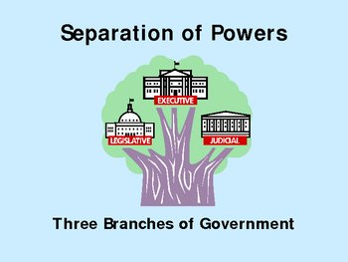
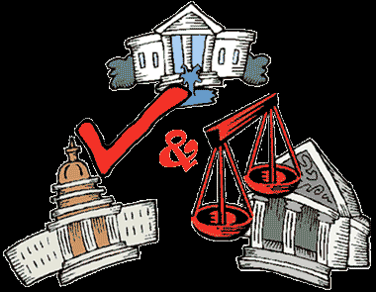
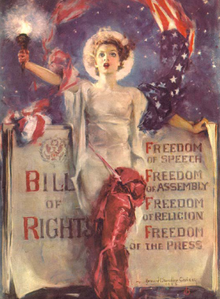
Concept
The Principles of the Constitution Continued
5. Separation of Powers – (do your own thing) each branch of the government has its own responsibilities. Idea from Marquis de Montesquieu.
3 Branches of Government
Legislative Branch – Congress, bicameral (two houses), makes laws
Executive Branch – President, enforces laws
Judicial Branch – Supreme Court, interprets laws
6. Checks and Balances – (I’m telling on you/I’m stopping you) each branch can check, or limit, the power of the other branches. Keep any branch from abusing their power or our rights.
7. Individual Rights – (yes I can) basic liberties and rights of all citizens are guaranteed in the Bill of Rights. From John Locke “Purpose of government is to protect our natural rights.

Slide 7
Principles Closure
  Go to Google Classroom and take Principles of the Constitution CFA

